Slide 1
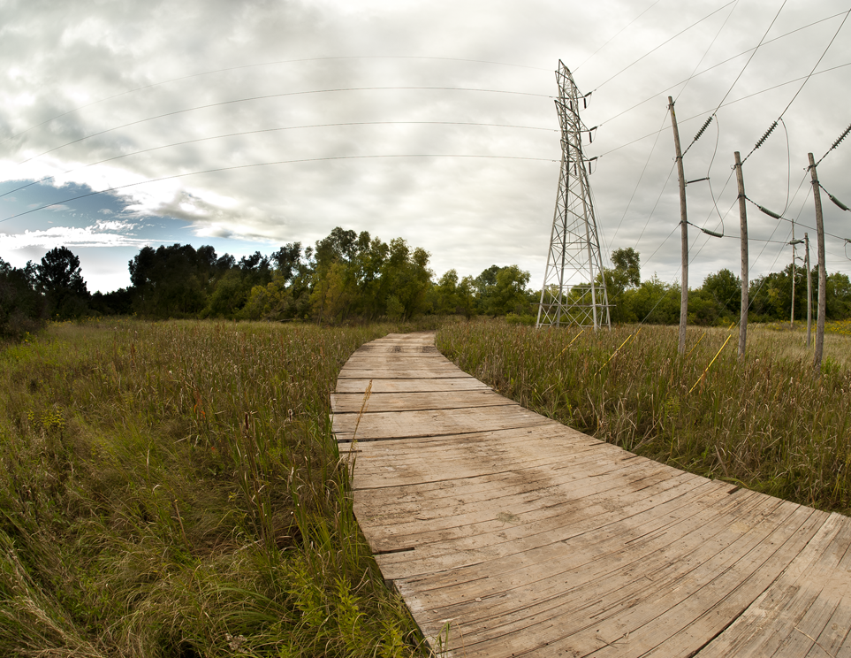
Benefits of
Ground Protection
Matting

Slide 2
Why Use Mats?
Greatly reduces soil disturbance = reduces threat to water quality
Minimizes crop and agricultural damage
Preserves existing hydrology by preventing ruts and compaction
4. Reduces time spent on each landowner’s property = less impact
5. Creates a defined, limited area of impact
*Not an environmental benefit, but SAFETY of work crews is always paramount. Important to have a firm, stable surface from which to work.

Slide 3
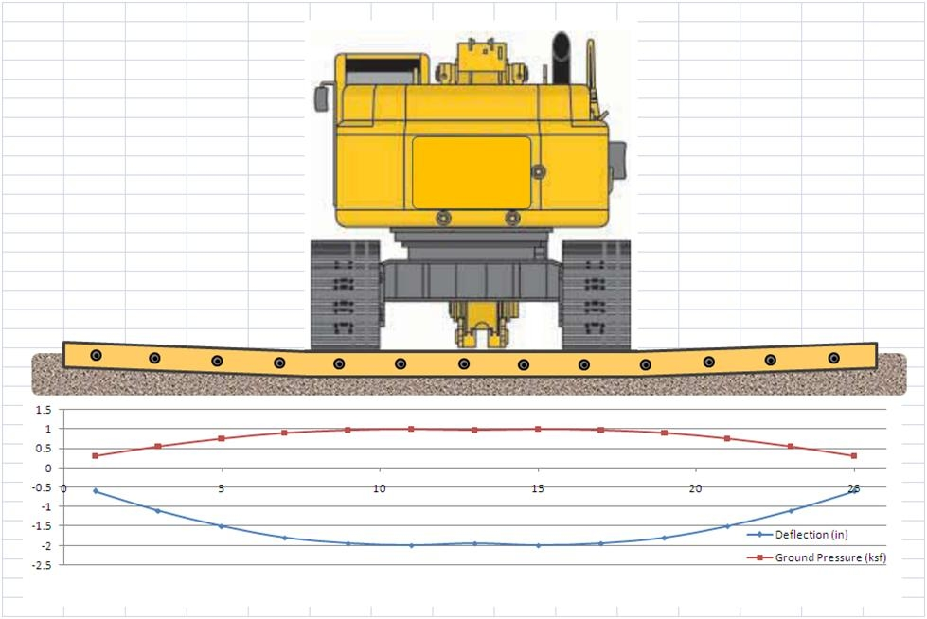
Protect Soil Structure
Equipment mats distribute the weight of equipment across a much larger area than the track or tire otherwise would.
A tire patch may be 1.5 to 2.5 square feet. Surface area under a track may be 15 to 40 square feet. A typical mat is 112 square feet.
Equipment loads often range from 2,000 KSF to 6,000 KSF (14 to 40 PSI). The use of matting often reduces the impact on the soil to half or less of these values.

Slide 4
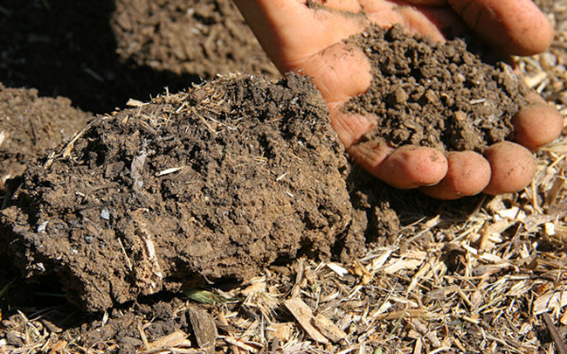
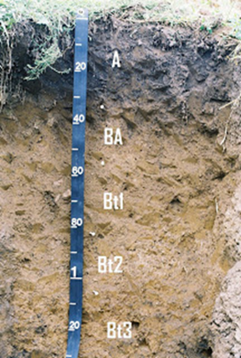
Protect Soil Structure
Healthy soil is 50% soil matter and 50% void space (air and water)
Soil structure (aggregation) is critical to root growth and nutrient uptake
Compacted/rutted soils can be de-compacted by disking or sub-soiling, but these practices disturb the soil horizons and structure. Preferable to protect soils during the project rather than try to restore afterwards.
Soil aggregation in the A Horizon
Soil Horizons

Slide 5
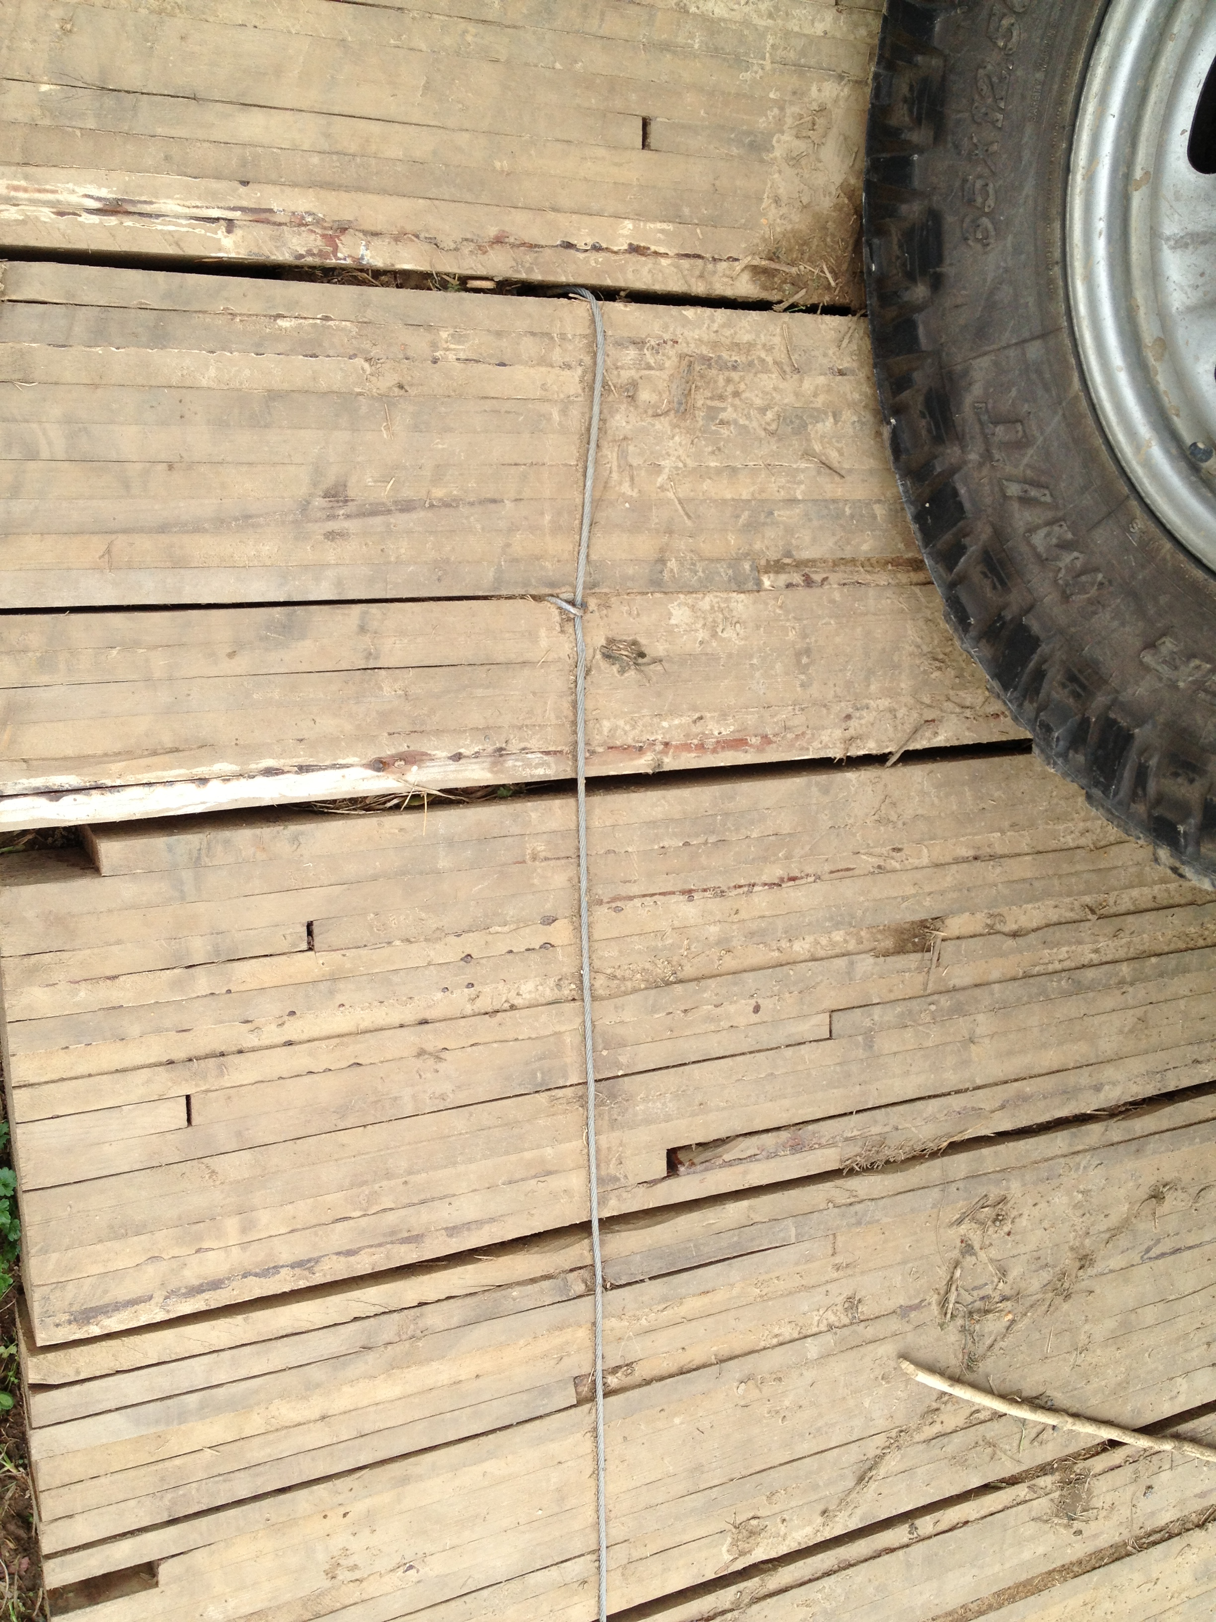
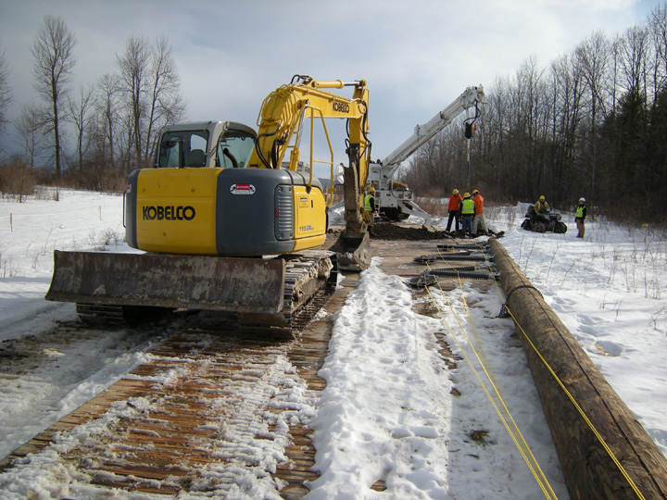
Load Distribution
The tensile strength of the mat material (wood, HDPE, bamboo, etc.) allows the mat to distribute a load in multiple directions across a large area (112+ SqFt). There are many different mat sizes and materials used to support all types of loads in a wide variety of soil conditions.

Slide 6
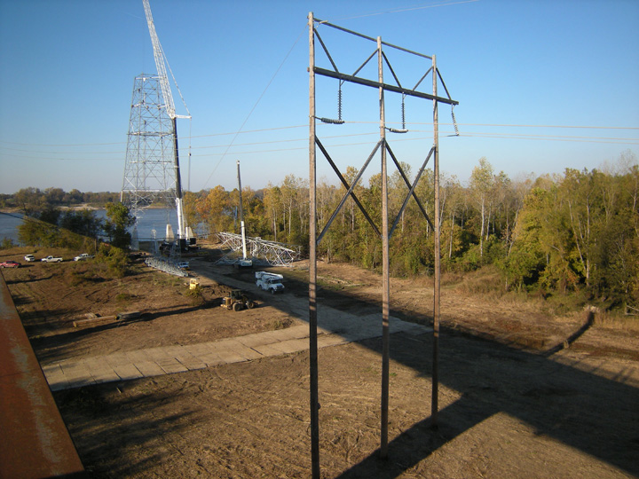
Protect Waterways
Matting provides access for cranes and trucks while preventing ruts and compaction, which allows for quick recovery and reduces the potential for sediment to enter waterways.

Slide 7
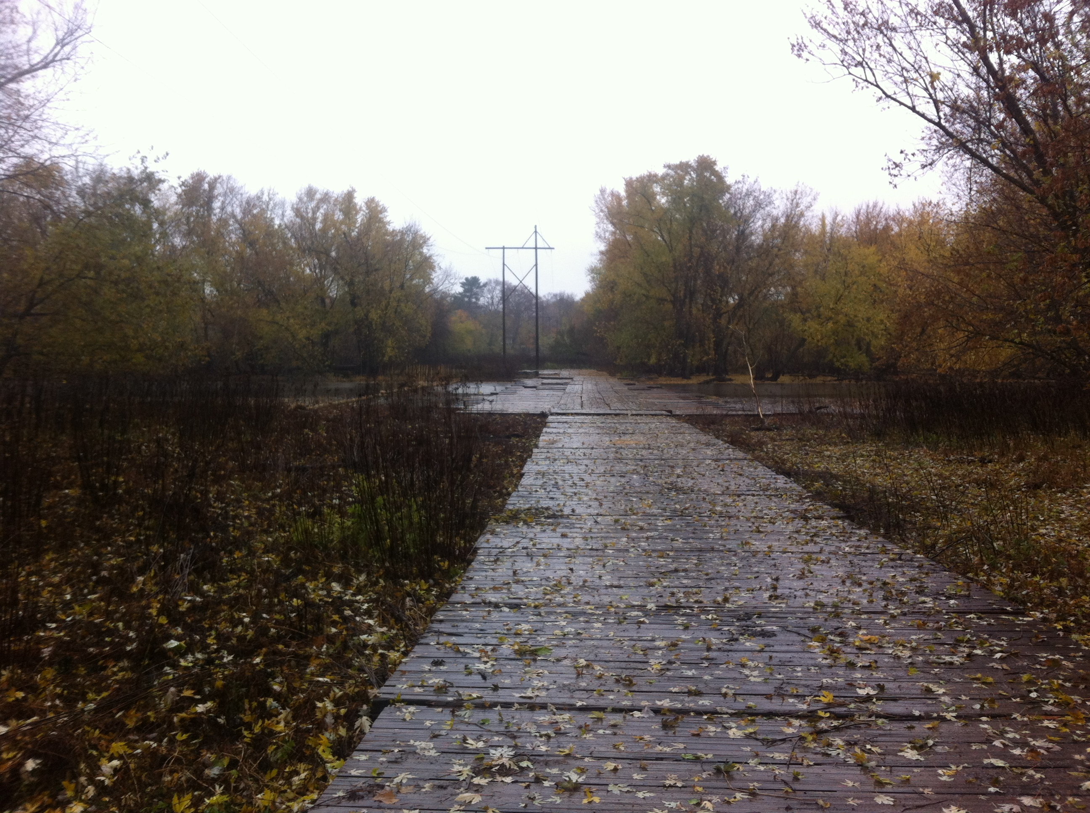
Protect Wetlands
Wetlands ecosystems are sensitive to disturbance. Protecting the root zone allows existing species to recover quickly. Protecting against ruts preserves a wetland’s delicate hydrology.

Slide 8
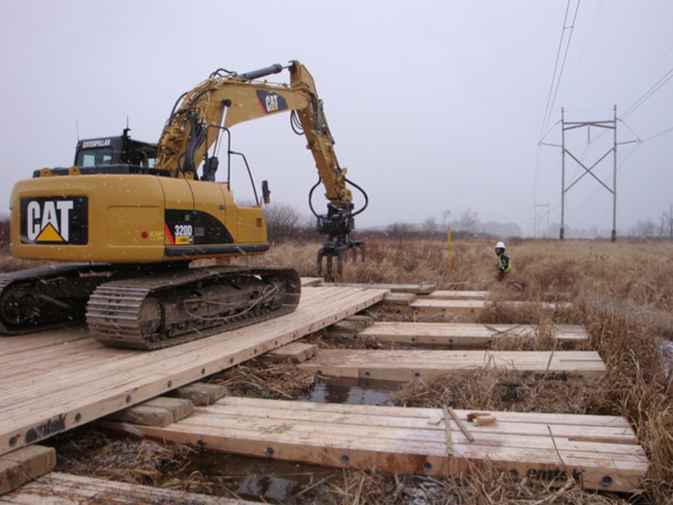
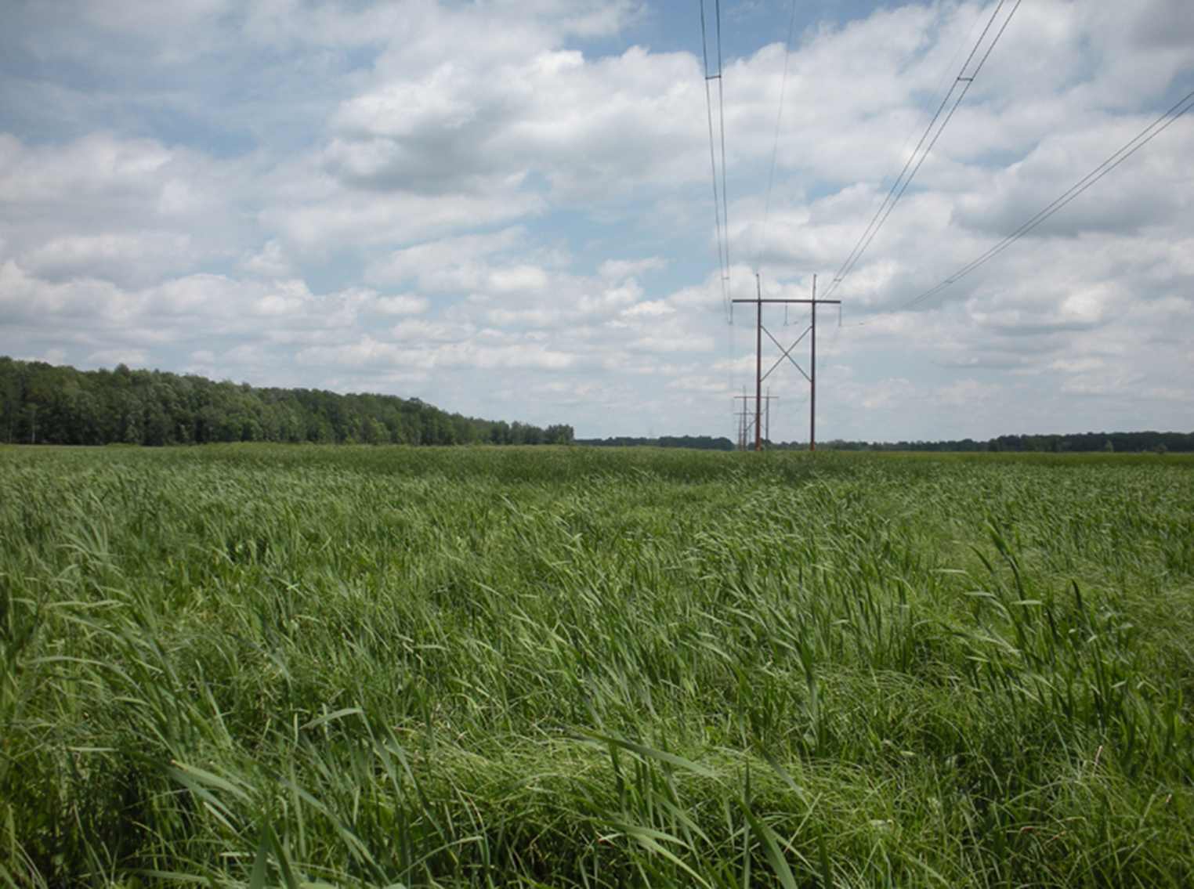
Protect Wetlands
An example of the fast, high-quality recovery seen on sites where matting is used appropriately. No restoration was needed on this right-of-way.
4 months after completion
During construction

Slide 9
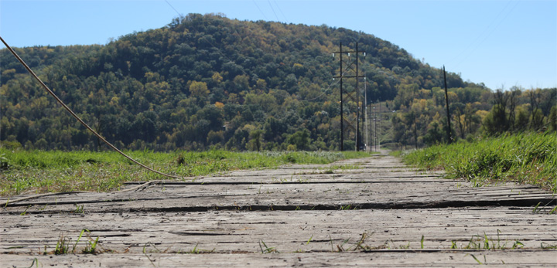
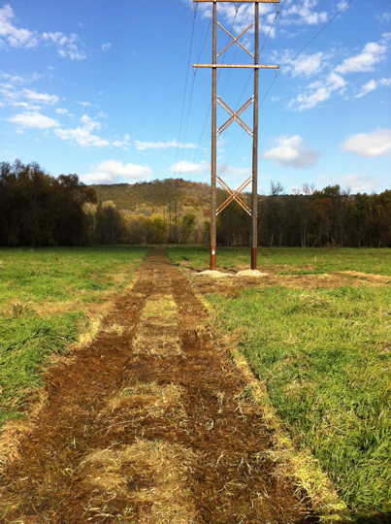
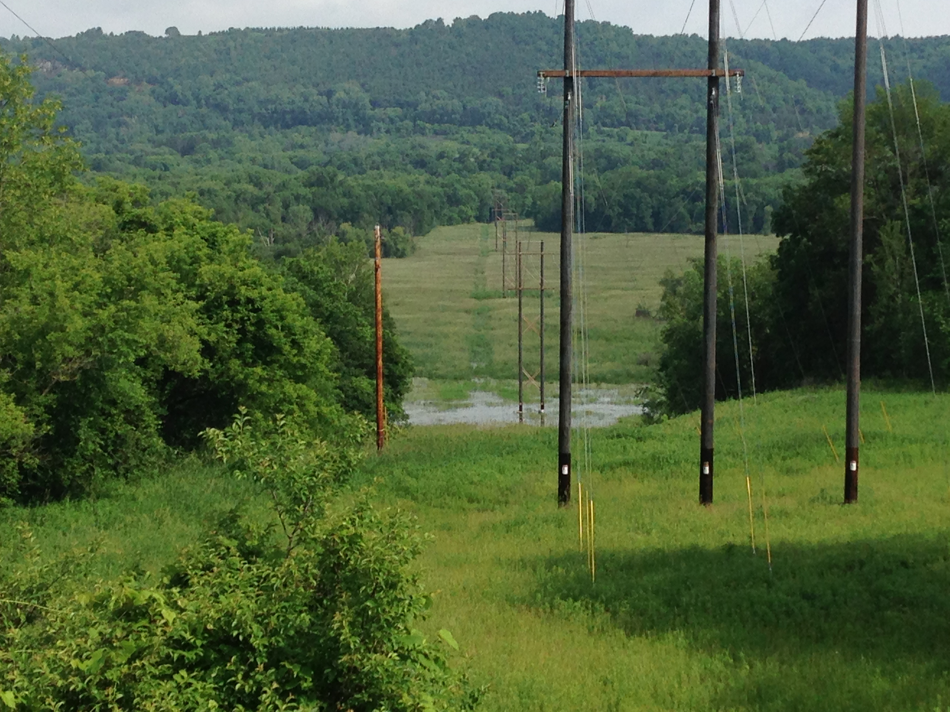
Protect Root Zone for Faster Recovery
During Construction
At completion
Matting for an extended duration will kill surface vegetation, but leaves the root structure of existing vegetation in tact, which allows for quick recovery times.
6 months after completion

Slide 10
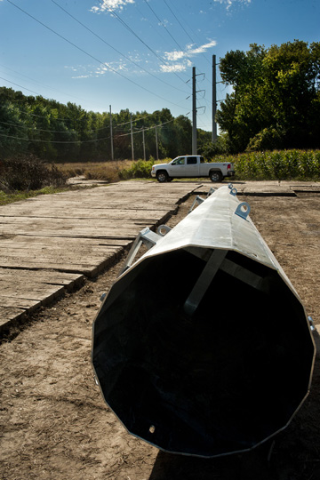
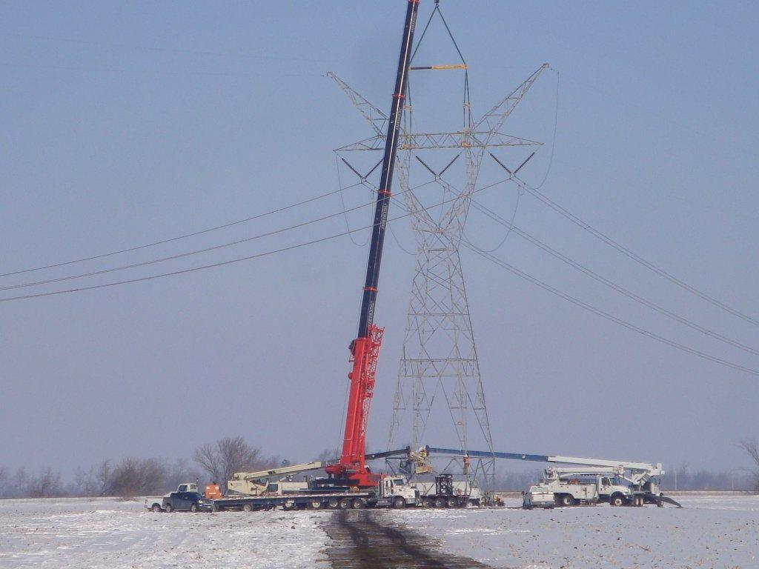
Reduce Agricultural Damage
Matting is the responsible approach for minimizing soil compaction on agricultural lands. Furthermore, by improving the efficiency of foundation and electrical crews, matting reduces the time spent on each landowner’s property.

Slide 11
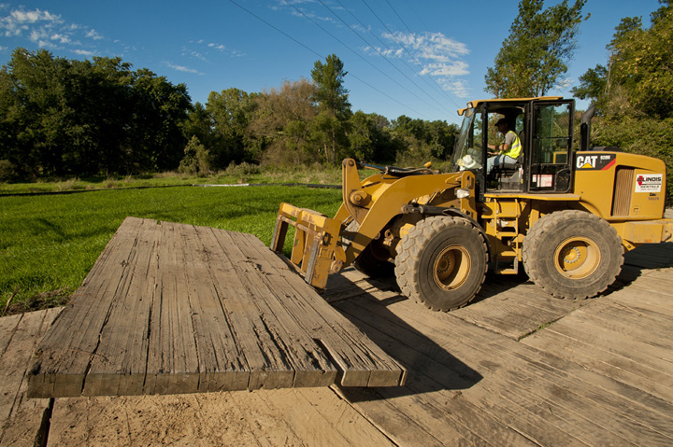
Limit Area of Impact
Matting helps to define an area of impact along the right of way. With matting in use, construction traffic is constrained to a 14’ to 18’ wide route. Without the use of matting, crews and equipment naturally tend to use a wider and wider area as the job progresses.

Slide 12
For more information or a free quote,
Contact us:
866.922.6287
www.newsouthmat.com
Copyright 2014 New South Access & Environmental Solutions. All Rights reserved.

